Slide 1
falconpy
Python 3 SDK for the CrowdStrike Falcon OAuth2 API
Notes:
Introduction

Slide 2
What is Falconpy?
FalconPy is a Python 3 solution for interacting with the CrowdStrike Falcon OAuth2 API
Community-driven, FalconPy is provided as a completely free and Open Source project
Notes:
FalconPy is a Python 3 solution for interacting with the CrowdStrike Falcon OAuth2 API
FalconPy supports Python versions 3.6 – 3.9 (3.5 also probably works but is not unit tested)
Due to dependencies, FalconPy will not work in Python 2.
The SDK was developed to assist developers in integrating with the CrowdStrike Falcon OAuth2 API and provides a solution for interaction with every operation available within every service collection.
A full wiki is also provided as part of the solution and will expand as the project matures.
FalconPy is currently in beta while we finalize patterns and complete the outstanding service classes.
Community-driven, FalconPy is provided as a completely free and Open Source project via GitHub
Released under the Unlicense license.
You are completely free to use or modify the source.
Since this is a project and not an official CrowdStrike product, CrowdStrike does not support FalconPy directly
There are support options within the project we will discuss later in this presentation

Slide 3

Package and Repository Details
Package name: crowdstrike-falconpy
Package URL: https://pypi.org/project/crowdstrike-falconpy/
Repository name: falconpy
Repository URL: https://github.com/CrowdStrike/falconpy
Notes:
FalconPy is distributed via the Python Package Index. The source is publicly available on GitHub.

Slide 4
Falconpy Components
One class per service collection
A single class that provides a harness for the entire API
Method defined for every API operation
Uber Class
Service Classes
Abstracts token interactions
Shell
Abstracts token interactions
Token refresh
Token refresh
Override
Overlays API on a terminal shell
Save / Load commands and payloads
Integrated debugger
Prototype syntax
Initial release: 03/21
Notes:
Service Classes – Structured, closely follow standard API SDK patterns.
Uber Class – A dynamic harness for the entire API. Usage is less structured, but unique functionality is provided.
Shell – Provides a way to test and model FalconPy usage and access a custom debugger. Also exposes additional functionality and toolsets.

Slide 5
falconpy Benefits
Faster API onboarding
Reduces code complexity
Easy to use
Reduces time to deliver your solution
Notes:
Easy to use
Simple to install, upgrade and remove.
Cross-Platform, Supports Windows, Mac and Linux environments
Reduces the code complexity for automation and integration tasks that interact with CrowdStrike deployments.
Reduces API onboarding
Reduces time to deliver custom applications and integrations that interact with the CrowdStrike OAuth2 API.

Slide 6
Usage

Slide 7
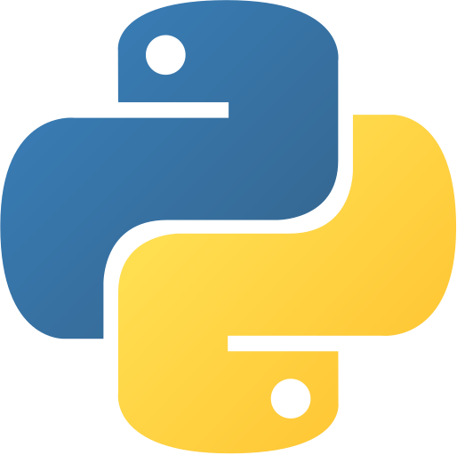
Package Installation AND removal
STANDARD INSTALLATION
$ python3 –m pip install crowdstrike-falconpy
BLEEDING EDGE / TESTING INSTALLATION
$ python3 –m pip install –I https://test.pypi.org/simple crowdstrike-falconpy
REMOVAL
$ python3 –m pip uninstall crowdstrike-falconpy
Notes:
Dependencies -
Requests
UrlLib3
Dependencies for contributors -
PyTest
Coverage
iPython

Slide 8
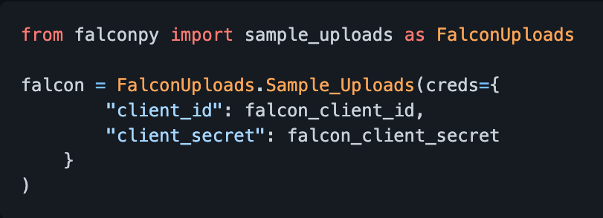
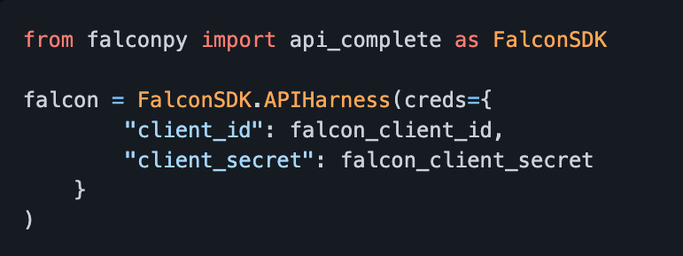
Authenticating to the API
SERVICE CLASS
UBER CLASS
Notes:
Both solutions can authenticate using just API credentials.

Slide 9
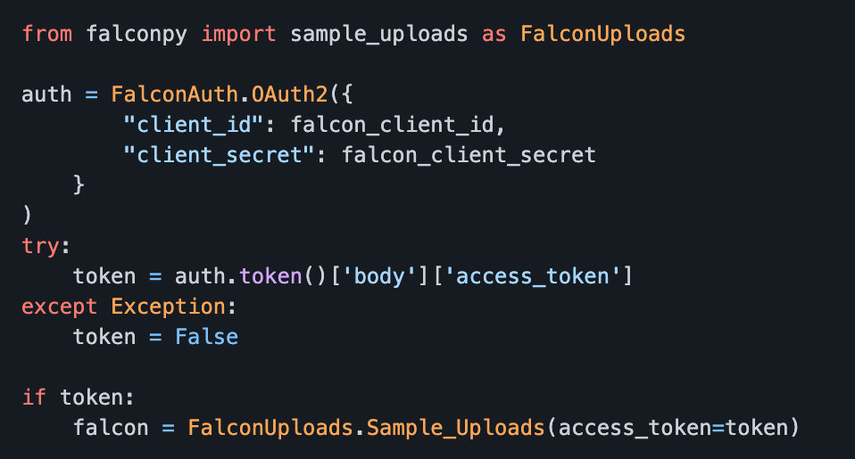
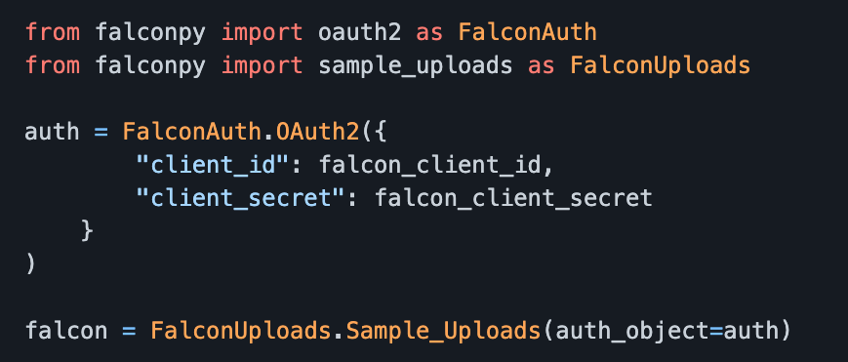
Authenticating to the API Service Class variations
Credential Authentication
Legacy Authentication
Object Authentication
Notes:
Service classes support multiple modes of authentication for each of the individual classes
The easiest to use is credential authentication, pass in the appropriate API credentials and the class is instantiated and authenticated to the API.
For scenarios where you may be handling multiple service classes, and you are also handling the OAuth2 service class, you have the option to use object authentication. This allows you to pass in an instance of the OAuth2 class during instantiation to use for authentication.
Finally, there is our legacy method of authentication for Service classes. You create an instance of the OAuth2 class and retrieve your token. Then you use this token to instantiate as many service classes as you need.
Please Note: Legacy authentication does not support automatic token refresh functionality.

Slide 10
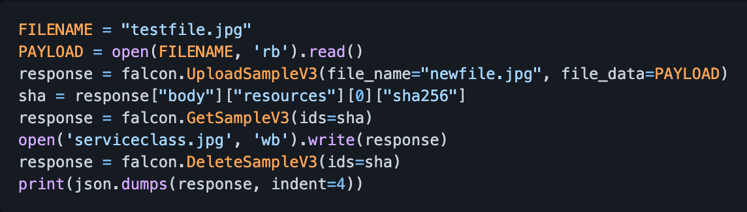
Service Class - Sample Uploads API Uploading a Sample, Downloading it, Then Deleting IT

Slide 11
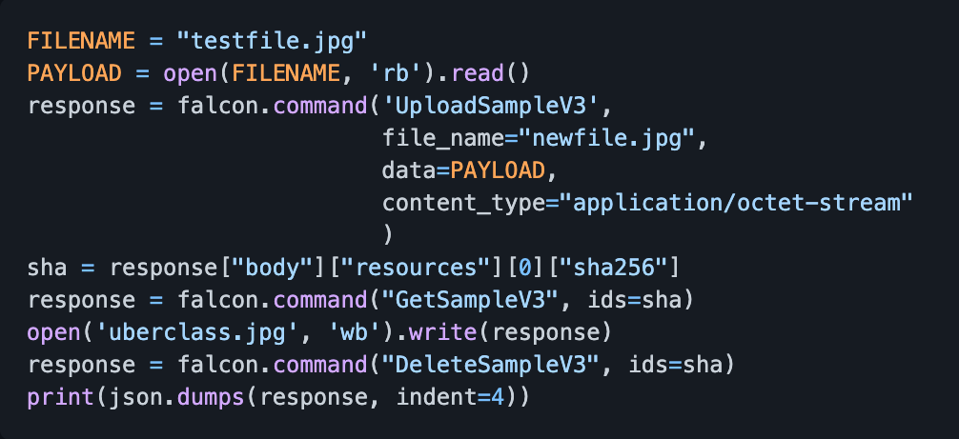
Uber Class - Sample Uploads API Uploading a Sample, Downloading it, Then Deleting IT

Slide 12
What’s next

Slide 13
FalconPy RoadMap
Outstanding service classes
FalconShell functionality expansion
v1.0 release
Classes to cover remaining API service collections
Enhanced command, response and batch handling
All base functionality available
Q2 2021
Q3 2021
Q4 2021
* Dates are tentative estimates only
Notes:
Soon to be released Service classes: (The Uber class already covers these endpoints)
Discover – Azure, GCP
Installation Tokens
Custom IOAs
MalQuery
IOA Exclusions
ML Exclusions
Sensor Visibility Exclusions
Quick Scan
Sensor Download

Slide 14
Join the FalconPy community
GitHub project: https://github.com/CrowdStrike/falconpy
GitHub wiki: https://github.com/CrowdStrike/falconpy/wiki
Bug reports: https://github.com/CrowdStrike/falconpy/issues
General discussion & requests: https://github.com/CrowdStrike/falconpy/discussions
Python Package Index page: https://pypi.org/project/crowdstrike-falconpy/

Slide 15
Questions

